Slide 1
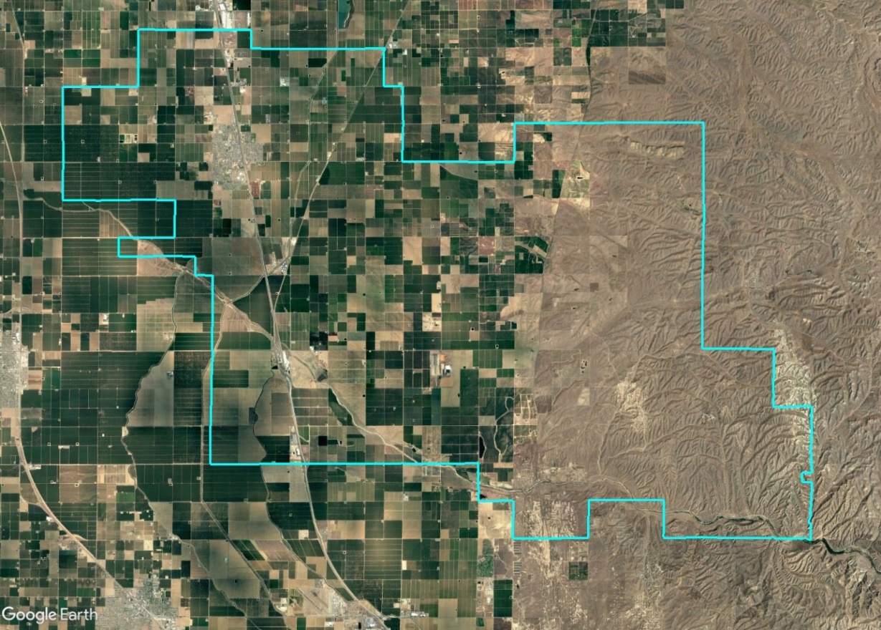
McFarland Recreation & Parks District Introduction to Districting
Dr. Jeff Tilton, Senior Consultant
National Demographics Corporation

Slide 2
Districting Process
Step | Description
Two Initial Hearings March 27 & April 10 | Held prior to release of draft maps Education and to solicit input on the composition of districts
Release draft maps April 17 | Maps must be posted at least 7 days prior to 3rd hearing
Two hearings on draft maps April 24 & May 15 | Two meetings to discuss and revise the draft maps and to discuss the election sequence
Map adoption May 22 | Map adopted via Resolution Final map must be posted at least 7 days prior to adoption

Slide 3
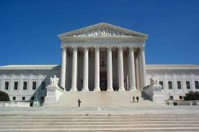
Districting Rules and Goals
1. Federal Laws
2. California Criteria
California Prohibition
Equal Population
Federal Voting Rights Act
No Racial Gerrymandering
In prioritized order:
Geographically contiguous
Avoid division of neighborhoods and “communities of interest” (Socio-economic geographic areas that should be kept together)
Avoid division of Cities and Census Designated Places
Easily identifiable boundaries
Compact (Do not bypass one group of people to get to a more distant group of people)
“Shall not adopt election district boundaries for the purpose of favoring or discriminating against an incumbent, political candidate, or political party.”
Other Traditional
Districting Principles
Future population growth

Slide 4
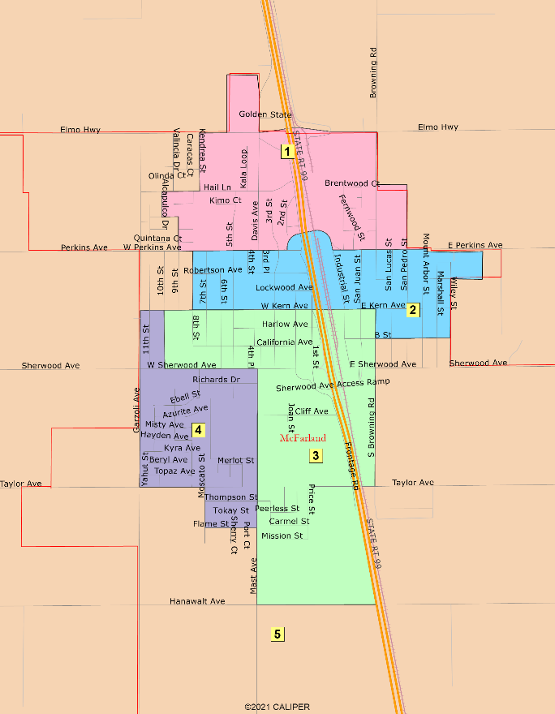
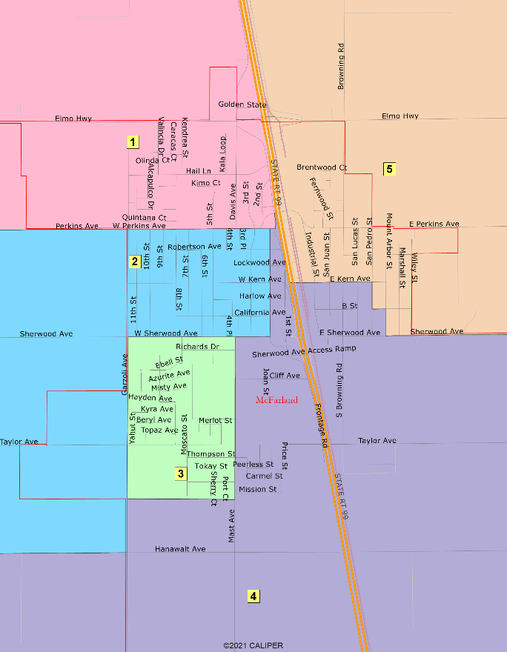
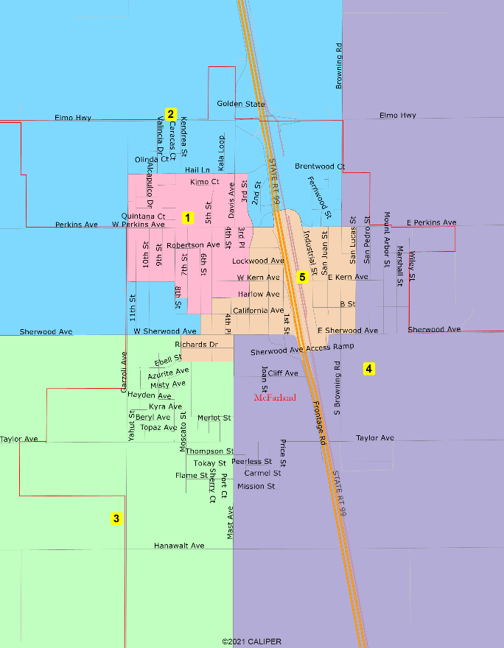
Draft Plans
Cherry
Green
Orange

Slide 5
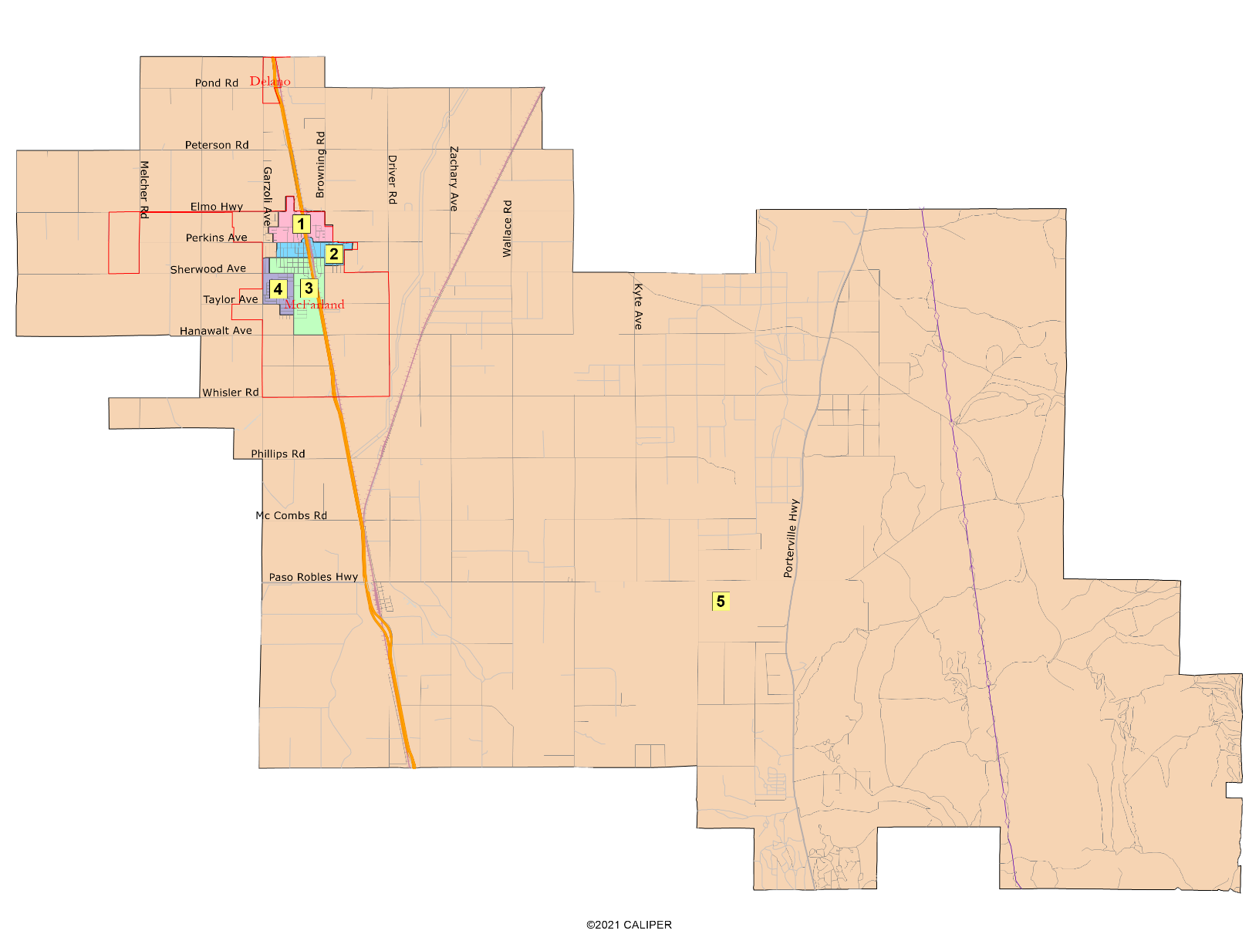
Cherry

Slide 6
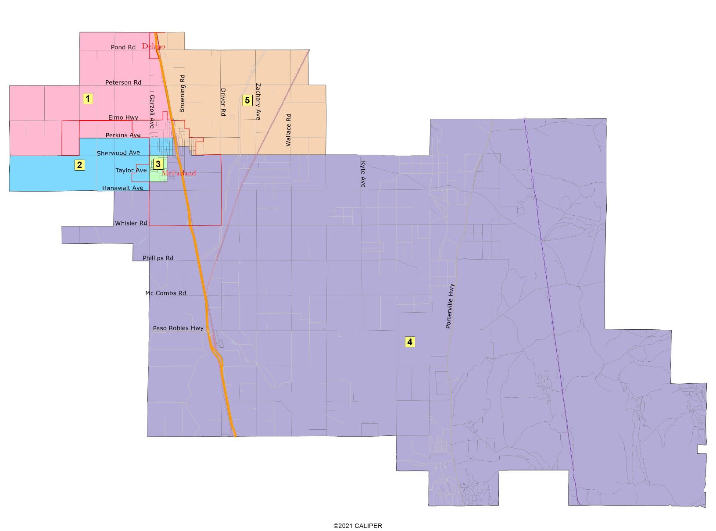
Green

Slide 7
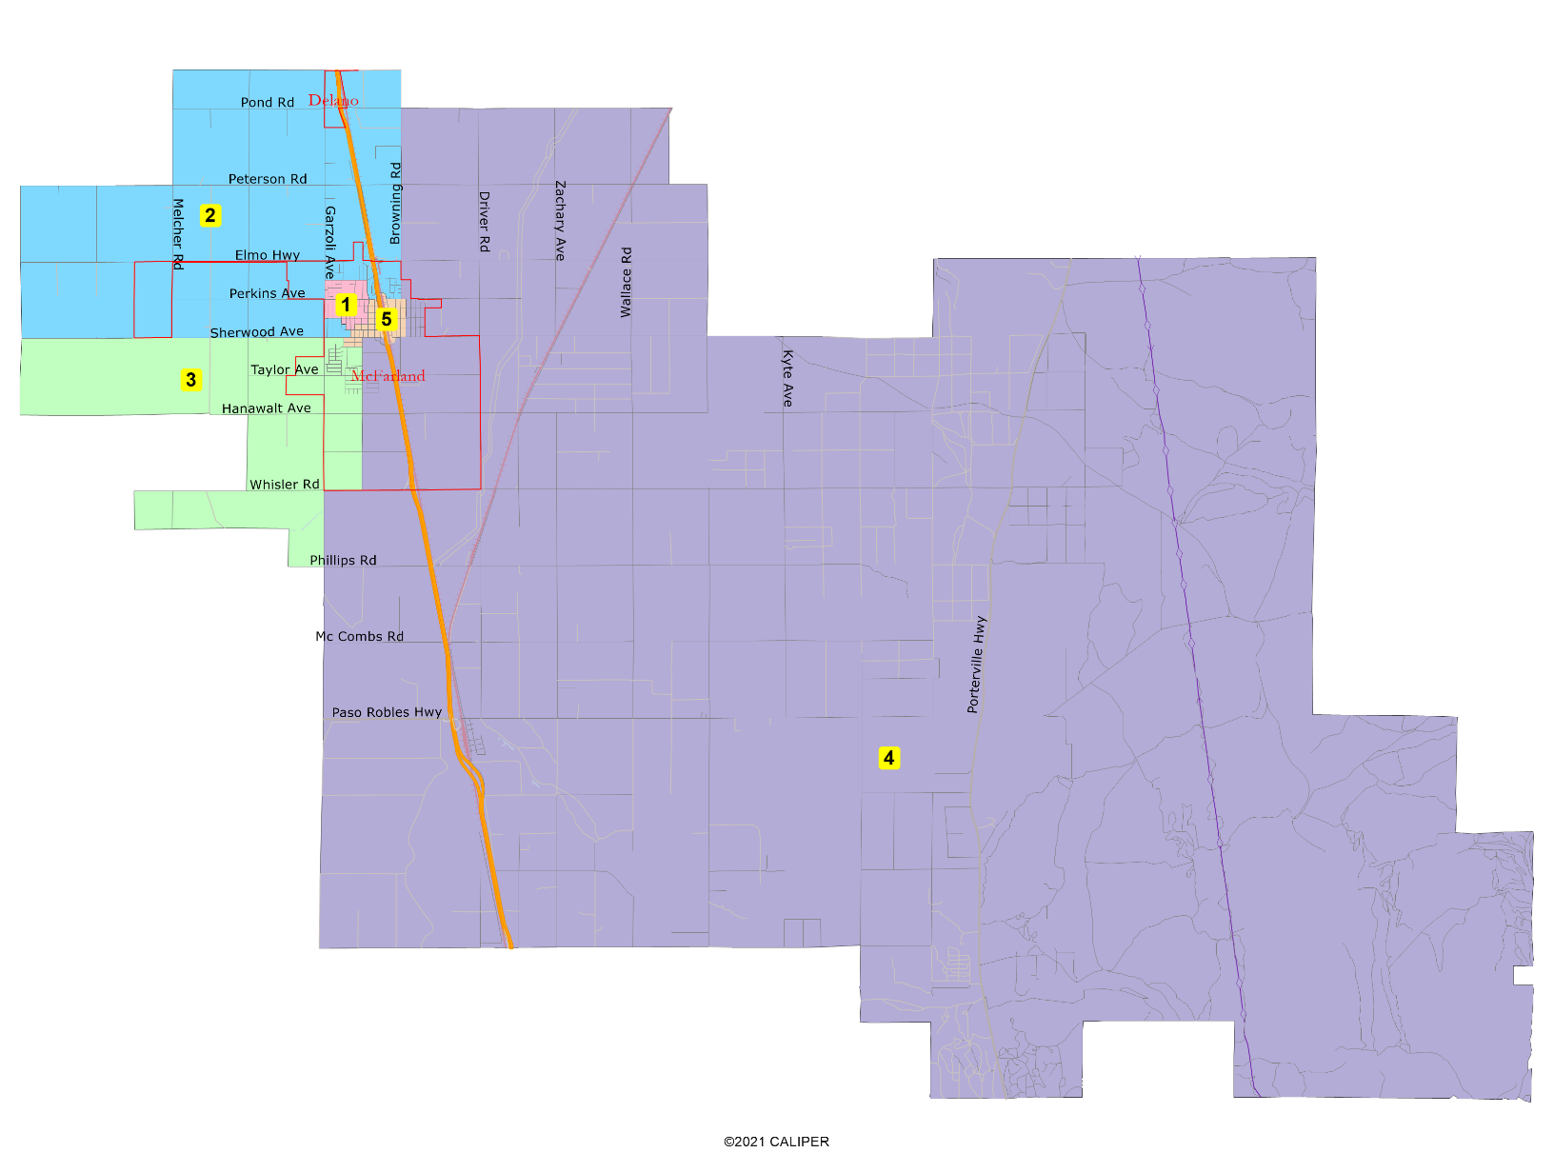
Orange

Slide 8
Hearing and Discussion
Cherry
Green
Orange

Slide 9
Share Your Thoughts
Website
mcfarlandrpd.com
Phone
661.792.3187
Email
jnickell@mcfarlandrpd.com

